Slide 1
SAL INSTITUTE OF TECHNOLOGY AND ENGEENIRING RESEARCH Ahmedabad B.E (3rd Semester)-Civil-Shift 2 December-2014 Group-3
Shah Disha R.(T-13CL247)
Gosai Beran M.(T-13CL207)
Chavda Hetal N.(T-13CL203)
Patel Keval K.(T-13CL223)
Patel Tejasvini D.(T-13CL225)

Slide 2
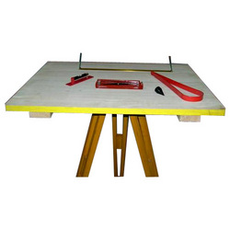
Plane Table Survey

Slide 3
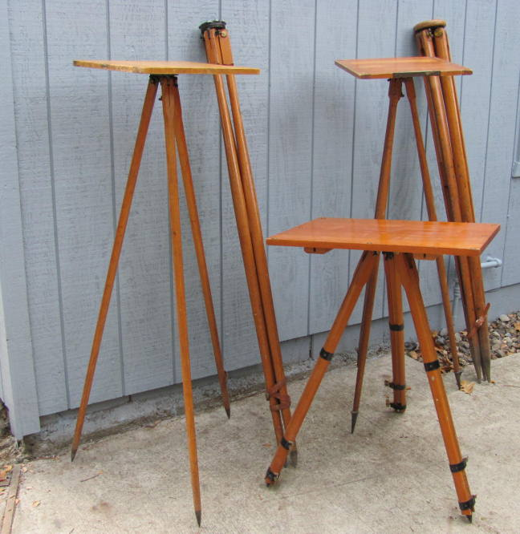
Content
Plane Table Surveying
Principle
Instruments
setting up the plane table
methods of plane tabling
Advantages & Disadvantages
sources of Errors.

Slide 4
Plane Table Surveying
Plane Table Surveying is a graphical method of survey in which the field observations and plotting are done simultaneously.
It is simple and cheaper than theodolite survey. It is most suitable for small scale maps.
The plan is drawn by the surveyor in the field, while the area to be surveyed is before his eyes. Therefore, there is no possibility of omitting the necessary measurements.

Slide 5
Principle Of Plane Table Survey
The principle of plane tabling is parallelism means,
Principle: “All the rays drawn through various details should pass through the survey station.”
The Position of plane table at each station must be identical, i.e. at each survey station the table must be oriented in the direction of magnetic north.

Slide 6
Principle Of Plane Table Survey

Slide 7
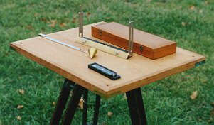
Equipments and Accessories for Plane Tabling
The following instruments are used in plane table surveying.
Equipments
Plane Table
Tripod
Alidade

Slide 8
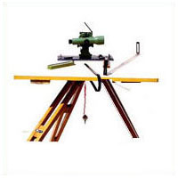
Equipments and Accessories for Plane Tabling
Accessories
Trough Compass
Spirit level
U-Fork with Plumb bob
Water proof cover
Drawing paper
Pins
Drawing accessories

Slide 9
Equipments
Plane Table:
The drawing board for plane tabling is made from well-seasoned wood with its upper surface exactly plane.
It is normally rectangular in shape with size 75 cm x 60 cm
It is mounted on a tripod and clamps are provided to fix it in any direction. The table can revolved about its vertical axis and can be clamped in any position, when necessary.

Slide 10
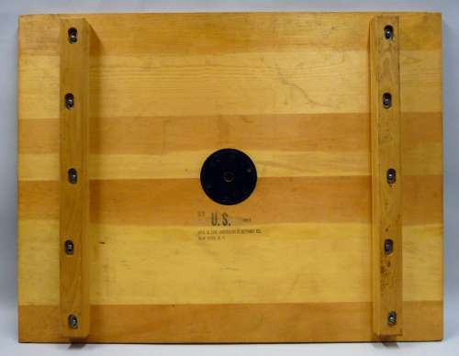
Plane Table

Slide 11
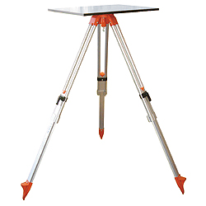
Plane Table

Slide 12
Tripod
The plane table is mounted on a tripod
The tripod is generally of open frame type, combined rigidity with lightness. The tripod may be made to fold for convenience of transportation.
Tripod is provided with three foot screws at its top for leveling of the plane table.

Slide 13
Tripod

Slide 14
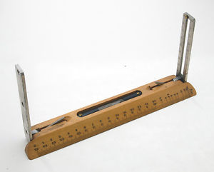
Alidade
The alidade is useful for establishing a line of sight.
Two Types of alidade are used.
Simple alidade
Telescopic alidade

Slide 15
Simple Alidade
It is used for ordinary work
It is generally consists of a gun metal or wooden rule with two vertical vanes at the ends.
The eye-vane is provided with a narrow slit while the object vane is open and carries a horse hair. Both the slits, thus provide a definite line of sight which can be made to pass through the object to be sighted

Slide 16
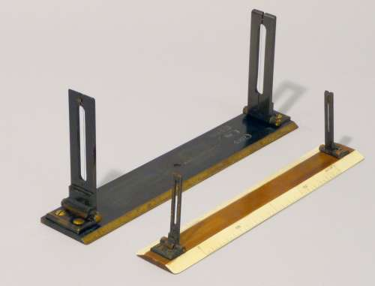
Simple Alidade

Slide 17
Simple Alidade
To draw the rays, one of the edge of alidade is beveled and this perfectly smooth working edge is known as the fiducially edge.
The fiducially edge is graduated to facilitate the plotting of distances to a scale.

Slide 18
Telescopic Alidade
The telescopic alidade is used when it is required to take inclined sights.
It essentially consists of a small telescope with a level tube and graduated arc mounted on horizontal axis.
It gives higher accuracy and more range of sights.

Slide 19
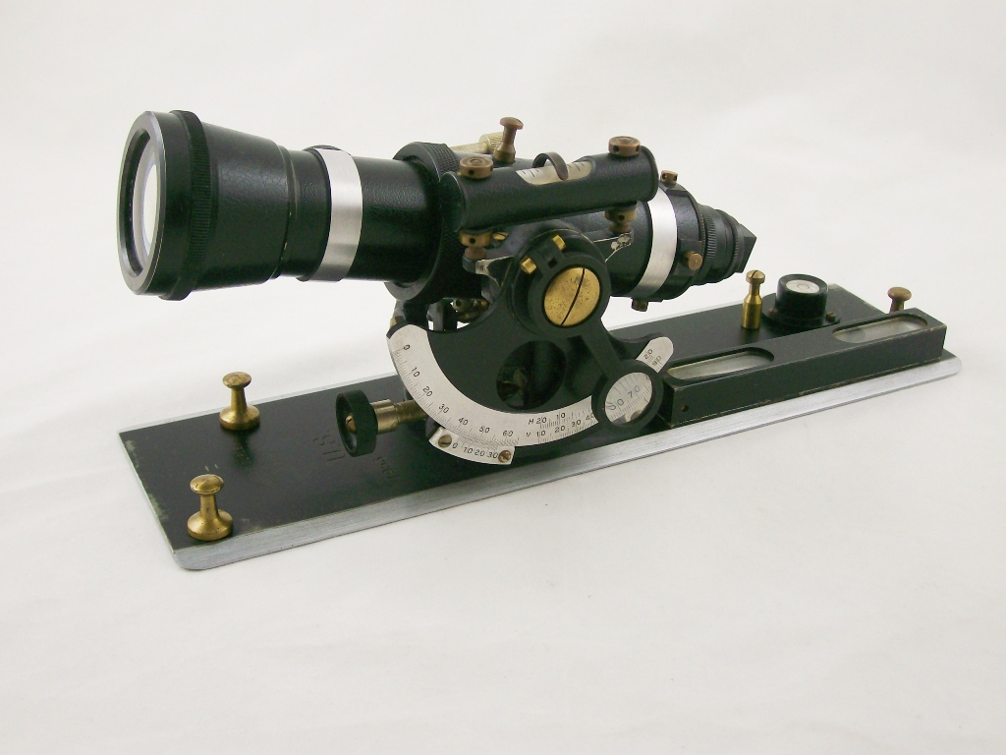
Telescopic Alidade

Slide 20
Telescopic Alidade

Slide 21
Accessories
Trough Compass
The trough compass is required for drawing the line showing magnetic meridian on the paper. It is used to orient the table to the magnetic meridian.
When the freely suspended needle shows 0⁰ at each end, a line is drawn on the drawing paper which represents the magnetic north.

Slide 22
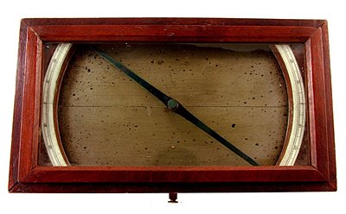
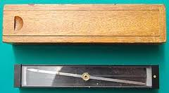
Trough Compass

Slide 23
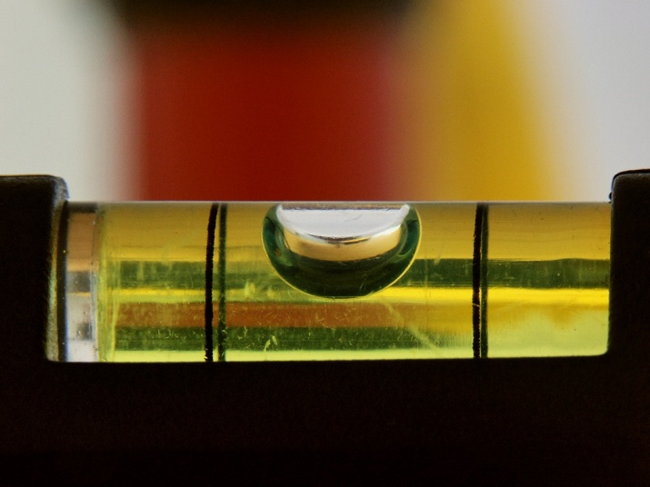
Spirit Level
A Spirit Level is used for ascertaining If the table is properly level.
The Table is leveled by placing the level on the board in two positions at right angles and getting the bubble central in both positions.

Slide 24
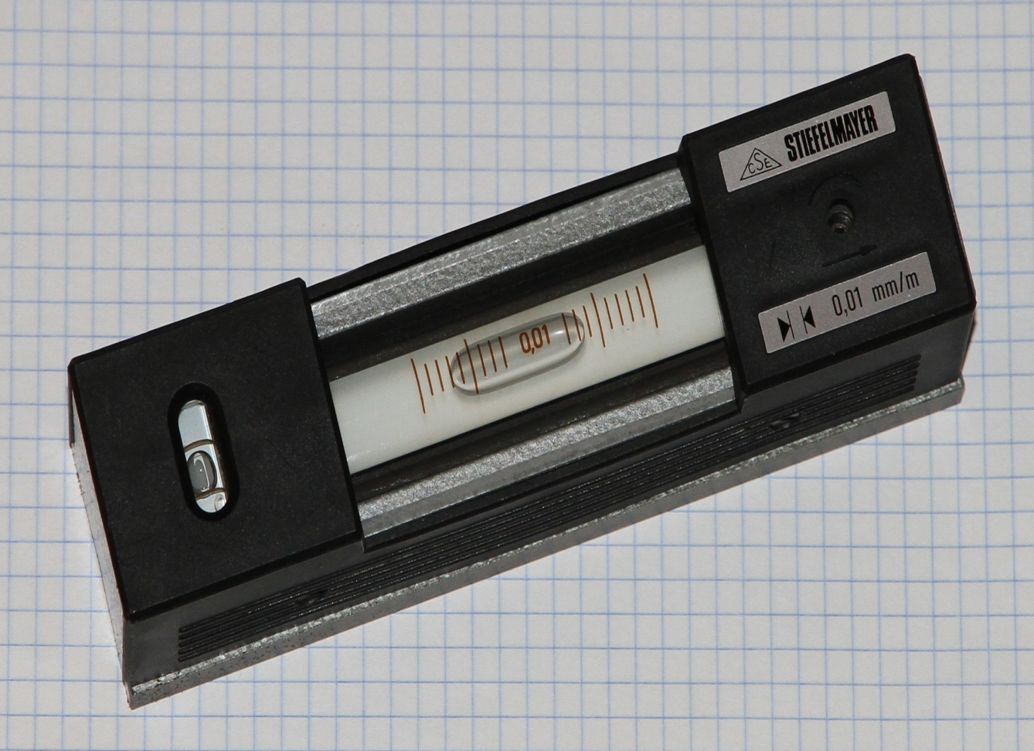
Spirit Level

Slide 25
U-Fork With Plumb bob
U-fork with plumb bob is used for centering the table over the point or station occupied by the plane table when the plotted position of that point is already on the sheet.
Also, in the beginning of the work, it is used for transferring the ground point on the sheet.

Slide 26
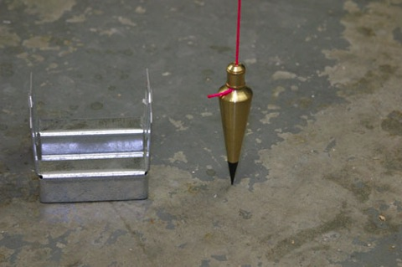
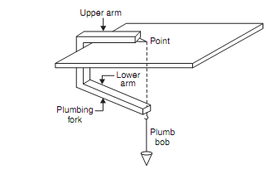
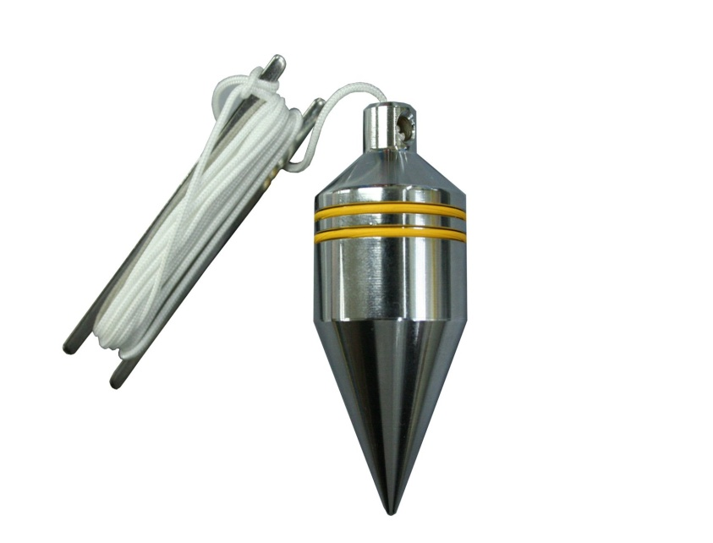
U-Fork With Plumb Bob

Slide 27
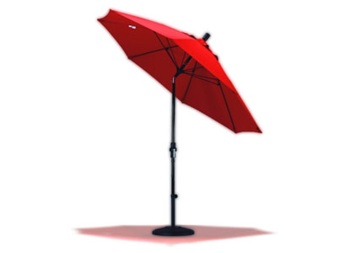
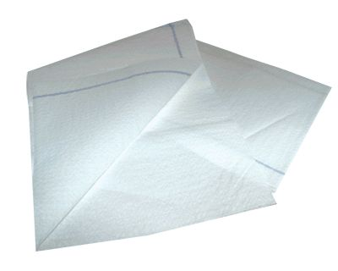
Water Proof Cover
An umbrella is used to protect the drawing paper from rain.

Slide 28
Drawing Paper
Drawing paper is used for plotting the ground details.

Slide 29
Setting Up the Plane table
Fixing the plane table on the tripod stand
Leveling the table
Centering the table
Marking the North-line
Orientation
Orientation by magnetic needle
Orientation by backsighting

Slide 30
Methods Of Plane Tabling
Radiation
Intersection
Traversing
Resection
Special Methods of Resection
Compass Method
Back-ray Method
Two-point problem
Three-point problem

Slide 31
Advantages and Disadvantages of Plane Table Surveying
Advantages:
The plan is drawn by the surveyor himself while the area to be surveyed is before his eyes. Therefore, there is no possibility of omitting the necessary measurements.
The surveyor Can compare the plotted work with the actual features of the area.

Slide 32
Advantages
It is simple and cheaper than the theodolite survey.
It is most suitable for small scale maps.
No great skill is required to produce a satisfactory map and work may be entrusted to a subordinate.
It is useful in magnetic areas where compass may not be used.
The mistakes in writing field books are eliminated.

Slide 33
Advantage

Slide 34
Disadvantages
Disadvantages (Limitations):
It is not intended for very accurate work.
It is not suitable in monsoon.
It is essentially a tropical instrument.
Due to heaviness, it is inconvenient to transport.
Since there are so many accessories, there is likelihood of them being lost.

Slide 35
Disadvantage

Slide 36
Sources of Errors
Instrumental Errors
Personal Errors
Errors of plotting

Slide 37
Thank You

